Slide 1
02. Problem Solving & Search
CSCI 561 - Foundation for Artificial Intelligence
Professor Wei-Min Shen
University of Southern California

Slide 2
Outline
Problem Solving and Search
- Search Space
Formulation of “Problem Solving” and Search
Complexity of Problems
- Search Algorithms (uninformed vs informed)
- Uninformed Search
Search strategies: breadth-first, uniform-cost, depth-first, bi-directional, …
- Informed Search (next lecture)
Search strategies: best-first, A*
Heuristic functions

Slide 3
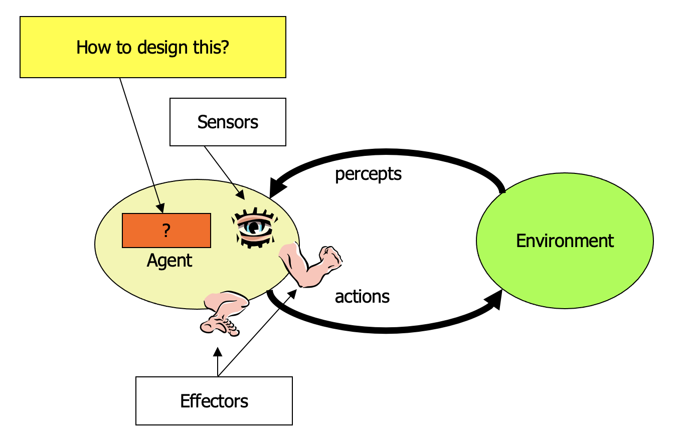
Review of General AI
Definition of AI?
Turing Test?
Intelligent Agents:
Anything that can be viewed as perceiving its environment through sensors and acting upon that environment through its effectors to maximize progress towards its goals.
PAGE (Percepts, Actions, Goals, Environment)
Described as a Perception (sequence) to Action Mapping: f : P* → A
Using look-up-table, closed form, etc.
Agent Types: Reflex, state-based, goal-based, utility-based
Rational Action: The action that maximizes the expected value of the performance measure given the percept sequence to date

Slide 4
Problem Solving What is a “problem”? How to define a “problem”?

Slide 5
An Example of “Problem” (Measuring Water)
9 l
5 l
3 l
Problem: Using these three buckets,
measure 7 liters of water.

Slide 6
Example: Measuring problem!
(one possible) Solution:
a b c
0 0 0 start
3 0 0
0 0 3
3 0 3
0 0 6
3 0 6
0 3 6
3 3 6
1 5 6
0 5 7 goal
9 l
5 l
3 l
a
b
c

Slide 7
Example: Measuring problem!
(one possible) Solution:
a b c
0 0 0 start
3 0 0
0 0 3
3 0 3
0 0 6
3 0 6
0 3 6
3 3 6
1 5 6
0 5 7 goal
9 l
5 l
3 l
a
b
c

Slide 8
Example: Measuring problem!
(one possible) Solution:
a b c
0 0 0 start
3 0 0
0 0 3
3 0 3
0 0 6
3 0 6
0 3 6
3 3 6
1 5 6
0 5 7 goal
9 l
5 l
3 l
a
b
c

Slide 9
Example: Measuring problem!
(one possible) Solution:
a b c
0 0 0 start
3 0 0
0 0 3
3 0 3
0 0 6
3 0 6
0 3 6
3 3 6
1 5 6
0 5 7 goal
9 l
5 l
3 l
a
b
c

Slide 10
Example: Measuring problem!
(one possible) Solution:
a b c
0 0 0 start
3 0 0
0 0 3
3 0 3
0 0 6
3 0 6
0 3 6
3 3 6
1 5 6
0 5 7 goal
9 l
5 l
3 l
a
b
c

Slide 11
Example: Measuring problem!
(one possible) Solution:
a b c
0 0 0 start
3 0 0
0 0 3
3 0 3
0 0 6
3 0 6
0 3 6
3 3 6
1 5 6
0 5 7 goal
9 l
5 l
3 l
a
b
c

Slide 12
Example: Measuring problem!
(one possible) Solution:
a b c
0 0 0 start
3 0 0
0 0 3
3 0 3
0 0 6
3 0 6
0 3 6
3 3 6
1 5 6
0 5 7 goal
9 l
5 l
3 l
a
b
c

Slide 13
Example: Measuring problem!
(one possible) Solution:
a b c
0 0 0 start
3 0 0
0 0 3
3 0 3
0 0 6
3 0 6
0 3 6
3 3 6
1 5 6
0 5 7 goal
9 l
5 l
3 l
a
b
c

Slide 14
Example: Measuring problem!
(one possible) Solution:
a b c
0 0 0 start
3 0 0
0 0 3
3 0 3
0 0 6
3 0 6
0 3 6
3 3 6
1 5 6
0 5 7 goal
9 l
5 l
3 l
a
b
c

Slide 15
Example: Measuring problem!
(one possible) Solution:
a b c
0 0 0 start
3 0 0
0 0 3
3 0 3
0 0 6
3 0 6
0 3 6
3 3 6
1 5 6
0 5 7 goal
9 l
5 l
3 l
a
b
c

Slide 16
Example: Measuring problem!
Another Solution:
a b c
0 0 0 start
0 5 0
3 2 0
3 0 2
3 5 2
3 0 7 goal
9 l
5 l
3 l
a
b
c

Slide 17
Example: Measuring problem!
Another Solution:
a b c
0 0 0 start
0 5 0
3 2 0
3 0 2
3 5 2
3 0 7 goal
9 l
5 l
3 l
a
b
c

Slide 18
Example: Measuring problem!
Another Solution:
a b c
0 0 0 start
0 5 0
3 2 0
3 0 2
3 5 2
3 0 7 goal
9 l
5 l
3 l
a
b
c

Slide 19
Example: Measuring problem!
Another Solution:
a b c
0 0 0 start
0 5 0
3 2 0
3 0 2
3 5 2
3 0 7 goal
9 l
5 l
3 l
a
b
c

Slide 20
Example: Measuring problem!
Another Solution:
a b c
0 0 0 start
0 5 0
3 2 0
3 0 2
3 5 2
3 0 7 goal
9 l
5 l
3 l
a
b
c

Slide 21
Example: Measuring problem!
Another Solution:
a b c
0 0 0 start
0 5 0
3 2 0
3 0 2
3 5 2
3 0 7 goal
9 l
5 l
3 l
a
b
c

Slide 22
Which solution do we prefer?
Solution 1:
a b c
0 0 0 start
3 0 0
0 0 3
3 0 3
0 0 6
3 0 6
0 3 6
3 3 6
1 5 6
0 5 7 goal
Solution 2:
a b c
0 0 0 start
0 5 0
3 2 0
3 0 2
3 5 2
3 0 7 goal

Slide 23
How to Define a “Problem”?
Measure 7 liters of water using a 3-liter, a 5-liter, and a 9-liter buckets.
Formulate Problem:
States: amount of water in the buckets
Operators/Actions: Fill bucket from source, empty bucket
Initial State: three empty buckets
Goal State: Have 7 liters of water in 9-liter bucket
Find solution: a sequence of operators/actions that bring your
agent from the initial/current state to the goal state

Slide 24
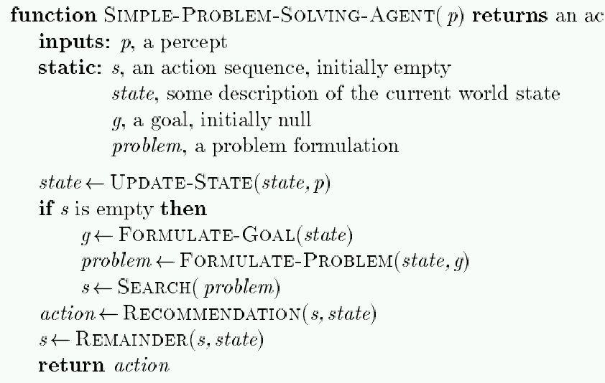
Problem-Solving Agent
action
// What is the current state?
// From LA to San Diego (given curr. state)
// e.g., Gas usage
// If fails to reach goal, update
Note: This is offline problem-solving. Online problem-solving involves acting w/o complete knowledge of the problem and environment

Slide 25
Remember: Environment Types
Environment | Accessible | Deterministic | Episodic | Static | Discrete
Operating System | Yes | Yes | No | No | Yes
Virtual Reality | Yes | Yes | Yes/No | No | Yes/No
Office Environment | No | No | No | No | No
Mars | No | Semi | No | Semi | No
The environment types largely determine the design of agent

Slide 26
Types of “Problems”
Single-state problem: deterministic, accessible (totally observable)
Agent knows everything about world, thus can
calculate optimal action sequence to reach goal state.
Multiple-state problem: deterministic, inaccessible (partially observable)
Agent must reason about sequences of actions and
states assumed while working towards goal state.
Contingency problem: nondeterministic, inaccessible
Must use sensors during execution
Solution is a tree or policy
Often interleave search and execution
Exploration problem: unknown state space
Discover and learn about environment while taking actions.

Slide 27
Problem types
Single-state problem: deterministic, accessible
Agent knows everything about world (the exact state),
Can calculate optimal action sequence to reach goal state.
E.g., playing chess. Any action will result in an exact state
Why is Chess or Go “accessible”?

Slide 28
Problem types
Multiple-state problem: deterministic, inaccessible
Agent does not know the exact state (could be in any of the possible states)
May not have sensors at all
Assume states while working towards goal state.
E.g., walking in a dark room, or playing the poker game
If you are at the door, going straight will lead you to the kitchen
If you are at the kitchen, turning left leads you to the bedroom
…

Slide 29
Problem types
Contingency problem: nondeterministic, inaccessible
Must use sensors during execution
Solution is a tree or policy
Often interleave search and execution
E.g., a new skater in an arena
Sliding problem.
Many skaters around

Slide 30
Problem types
Exploration problem: unknown state space
Discover and learn about environment while taking actions.
E.g., Maze, or Mars

Slide 31
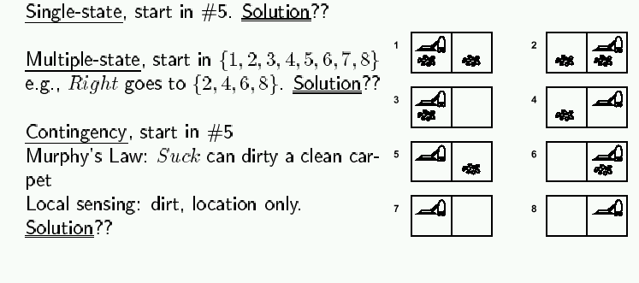
Example 1: Vacuum world
Simplified world: 2 locations, each may or not contain dirt,
each may or not contain vacuuming agent.
Goal of agent: clean up the dirt.

Slide 32
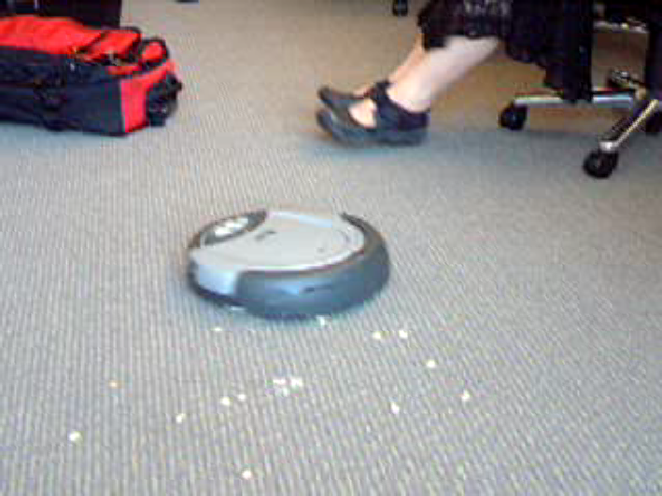

Slide 33
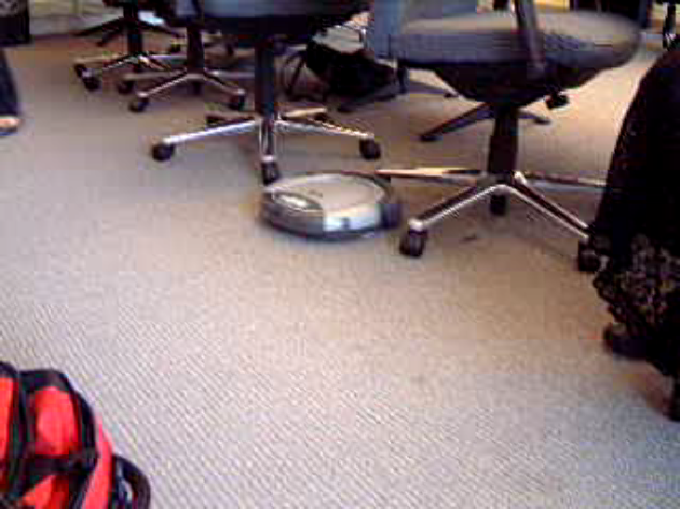

Slide 34
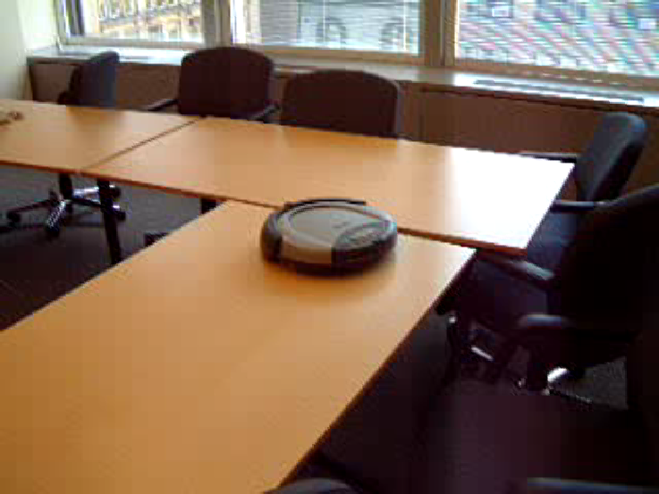

Slide 35
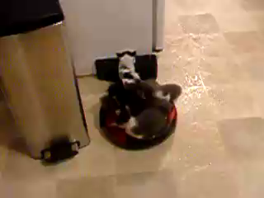

Slide 36
Example 2: Traveling in Romania
In Romania, on vacation. Currently in Arad.
Flight leaves tomorrow from Bucharest.
Formulate goal:
Be in Bucharest
Formulate problem:
States: various cities
Operators: drive between cities
Find solution:
Sequence of cities, such that total driving distance is minimized.

Slide 37
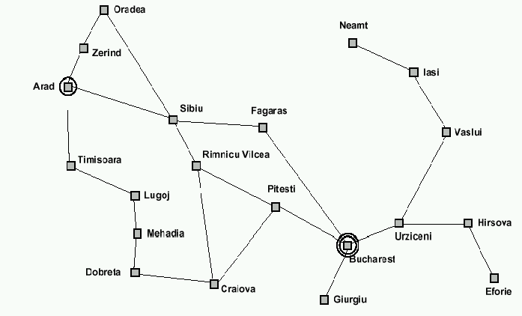
Example: Traveling from Arad To Bucharest

Slide 38
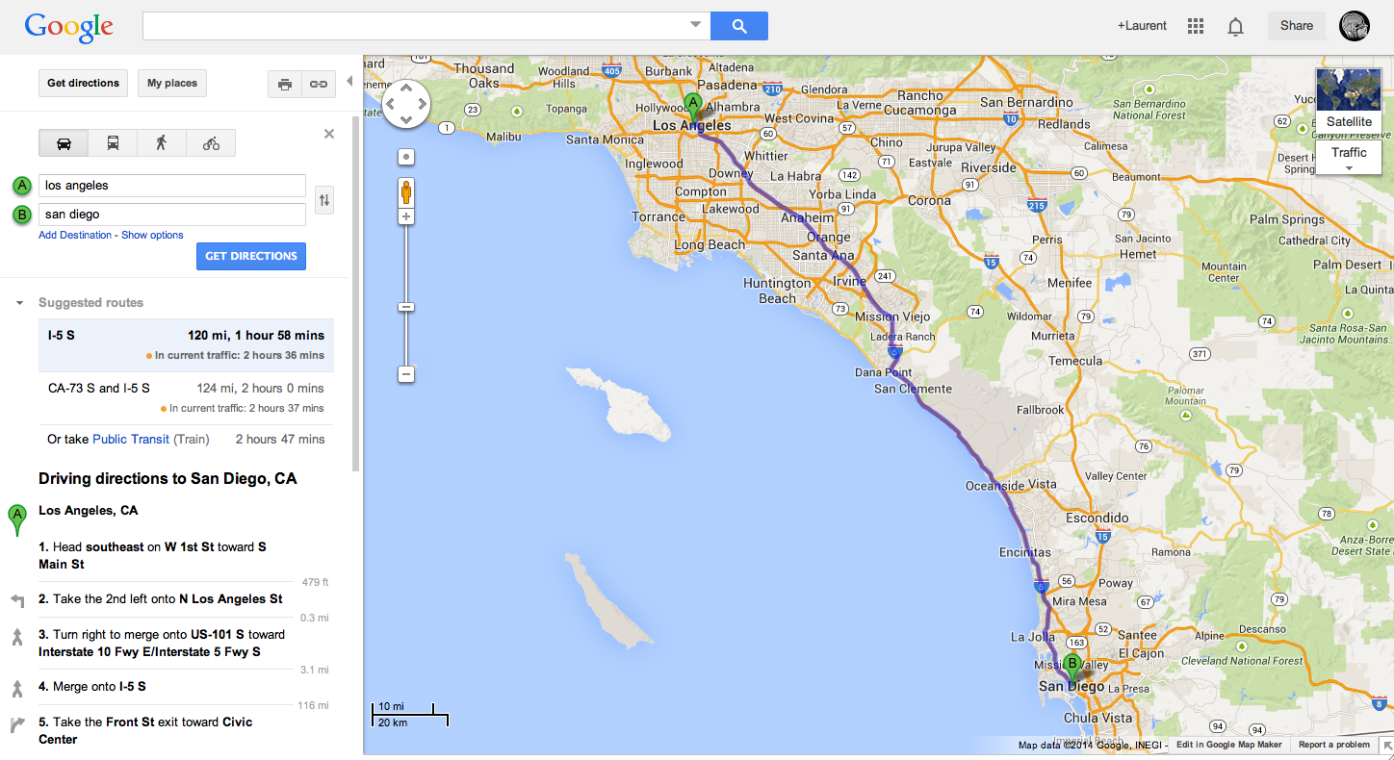

Slide 39
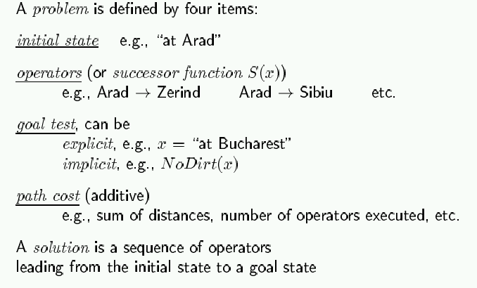
The General Formulation of “Problem”

Slide 40
Selecting a Space of States
Real world is absurdly complex; some abstraction is necessary to allow us to reason on it…
Selecting the correct abstraction and resulting state space is a difficult problem!
Abstract states ⬄ real-world states
Abstract operators ⬄ sequences or real-world actions
(e.g., going from city i to city j costs Lij ⬄ actually drive from city i to j)
Abstract solution ⬄ set of real actions to take in the
real world such as to solve problem

Slide 41

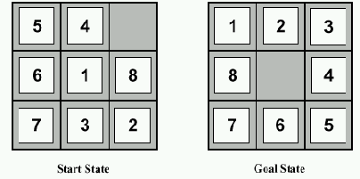
Example 3: 8-puzzle
start state
goal state
State:
Operators:
Goal test:
Path cost:

Slide 42
Example: 8-puzzle
start state
goal state
State: integer location of tiles (ignore intermediate locations)
Operators: moving blank left, right, up, down (ignore jamming)
Goal test: does state match goal state?
Path cost: 1 per move

Slide 43
Example: 8-puzzle
start state
goal state
Why do we need search algorithms?
8-puzzle has 362,880 states
15-puzzle has 10^12 states
24-puzzle has 10^25 states
So, we need a principled way to look for a solution in these huge search spaces…

Slide 44
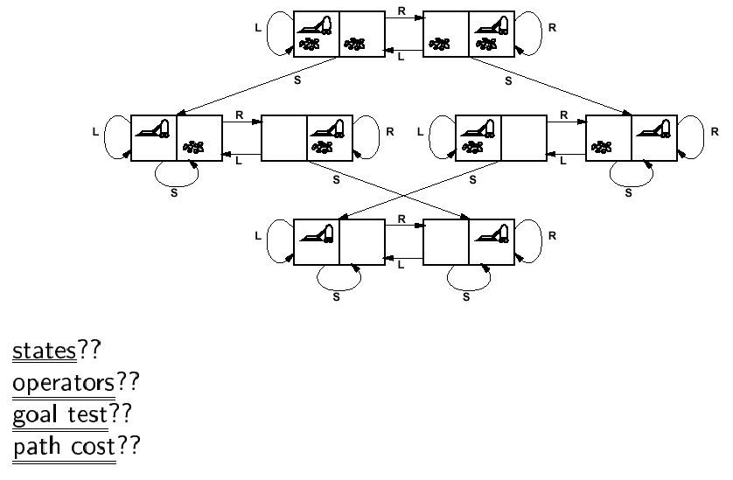
Back to Vacuum World

Slide 45
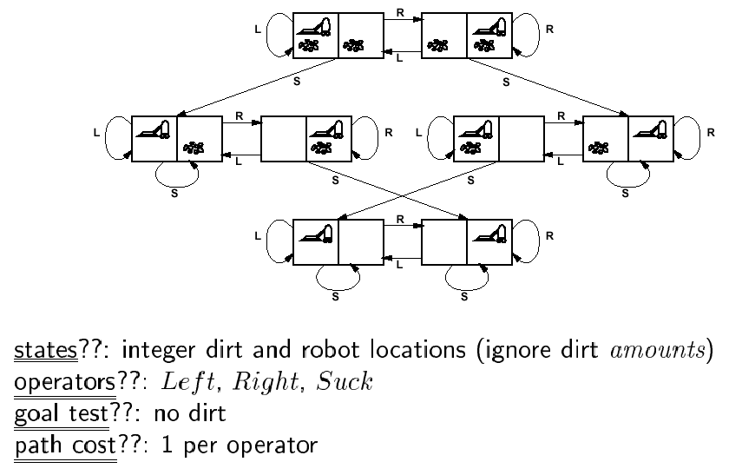
Back to Vacuum World

Slide 46
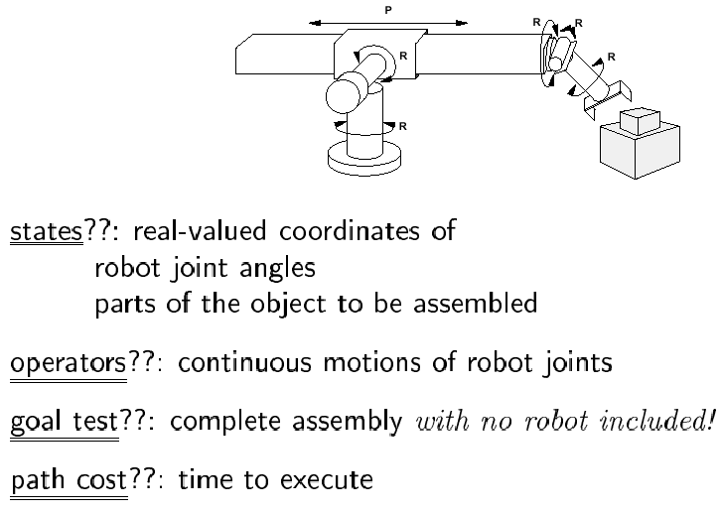
Example: Robotic Assembly

Slide 47
A Real-life Example: Circuit Board Layout
Given schematic diagram comprising components (chips, resistors, capacitors, etc) and interconnections (wires), find optimal way to place components on a printed circuit board, under the constraint that only a small number of wire layers are available (and wires on a given layer cannot cross!)
“optimal way”??
minimize surface area
minimize number of signal layers
minimize number of vias (connections from one layer to another)
minimize length of some signal lines (e.g., clock line)
distribute heat throughout board
etc.

Slide 48
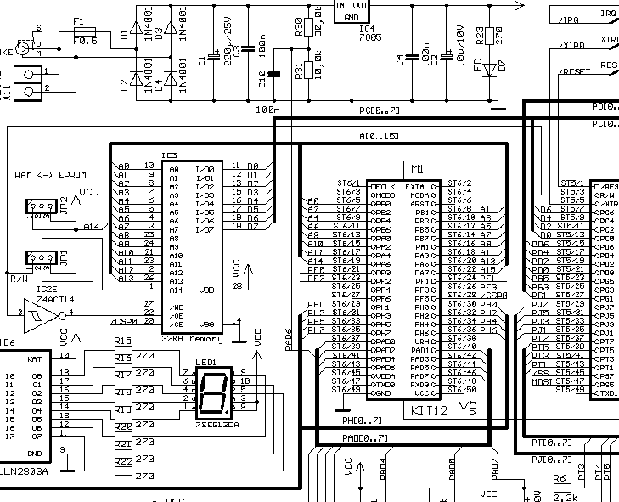

Slide 49
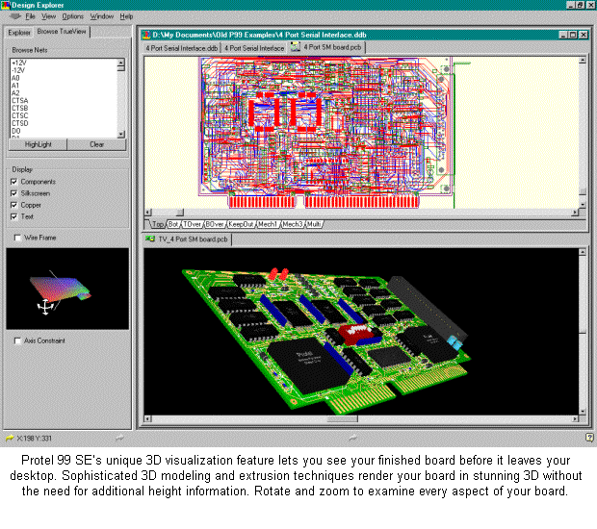
Use automated tools to place components
and route wiring.

Slide 50
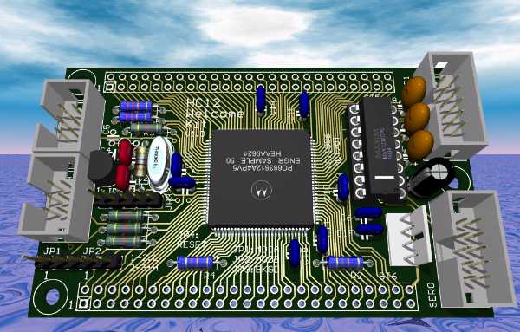

Slide 51
Search for solutions

Slide 52
Search Algorithms
Basic idea:
offline, systematic exploration of simulated state-space by generating successors of explored states (expanding)
Function General-Search(problem, strategy) returns a solution, or failure
initialize the search tree using the initial state problem
loop do
if there are no candidates for expansion then return failure
choose a leaf node for expansion according to strategy
if the node contains a goal state then
return the corresponding solution
else expand the node and add resulting nodes to the search tree
end

Slide 53
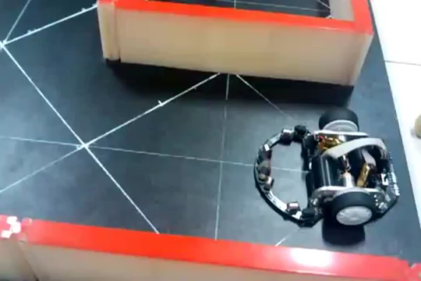
Example: A micro_mouse searches in a maze

Slide 54
Example: Traveling from Arad To Bucharest

Slide 55
From Problem Space to Search Tree
Some material in this and following slides is from
http://www.cs.kuleuven.ac.be/~dannyd/FAI/ check it out!
3
A
4
B
4
C
Problem space
S
5
5
G
4
D
E
F
3
2
4
3
S
4
4
A
D
5
5
2
Associated
loop-free
search tree
B
D
A
E
4
5
2
4
5
4
C
E
E
B
B
F
2
4
5
4
4
5
4
4
3
D
F
B
F
C
E
A
C
G
3
4
3
4
G
C
G
F
G
3

Slide 56
Paths in Search Trees
Denotes:
SA
S
A
Denotes:SDA
D
B
D
A
E
C
E
E
B
B
F
D
F
B
F
C
E
A
C
G
Denotes:
SDEBA
G
C
G
F
G

Slide 57
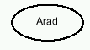
A General Search Example

Slide 58
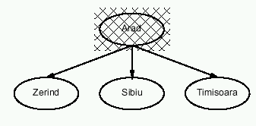
A General Search Example

Slide 59
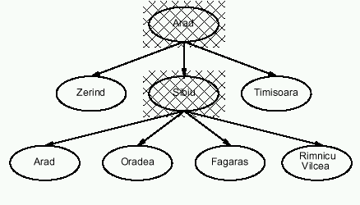
A General Search Example

Slide 60
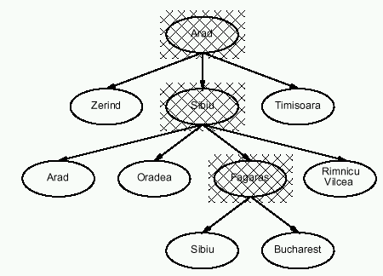
A General Search Example

Slide 61
An Implementation of Search Algorithms
Function General-Search(problem, Queuing-Fn) returns a solution, or failure
nodes ← make-queue(make-node(initial-state[problem]))
loop do
if nodes is empty then return failure
node ← Remove-Front(nodes)
if Goal-Test[problem] applied to State(node) succeeds then return node
nodes ← Queuing-Fn(nodes, Expand(node, Operators[problem]))
end
Queuing-Fn(queue, elements) is a queuing function that inserts a set of elements into the queue and determines the order of node expansion. Varieties of the queuing function produce varieties of the search algorithm.

Slide 62
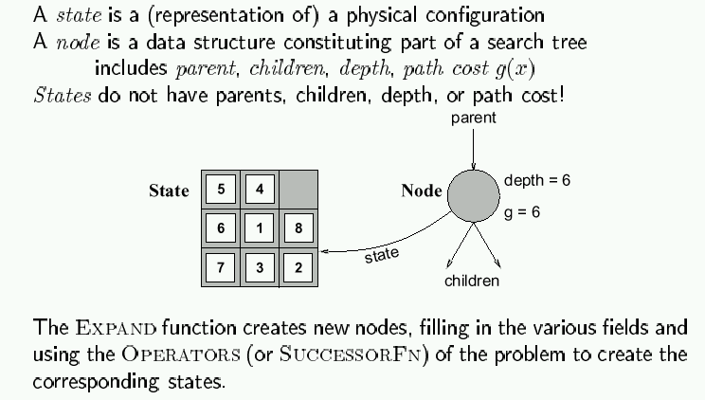
Encapsulating state information in nodes

Slide 63
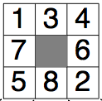
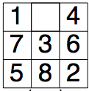
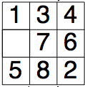
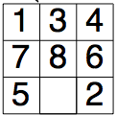
Paths in search trees
states
…

Slide 64
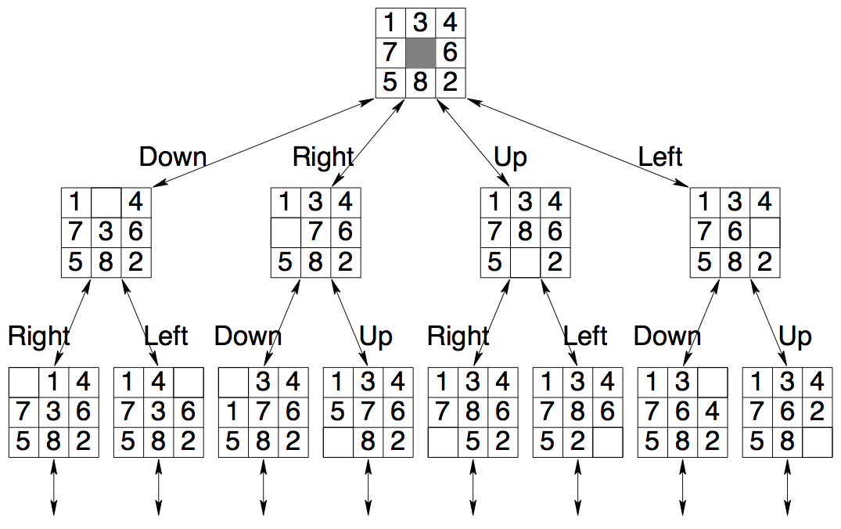
Paths in search trees
http://www.cs.utsa.edu/~bylander/cs5233/notes/search-exshandout.pdf
Search tree nodes

Slide 65
Evaluation of search strategies
A search strategy is defined by picking the order of node expansion
Search algorithms are commonly evaluated according to the following four criteria:
Completeness: does it always find a solution if one exists?
Time Complexity: how long does it take as function of num. of nodes?
Space Complexity: how much memory does it require?
Optimality: does it guarantee the least-cost solution?
Time and space complexity are measured in terms of:
b – max branching factor of the search tree
d – depth of the least-cost solution
m – max depth of the search tree (may be infinity)

Slide 66
Binary Tree Example
Depth = 0
root
Depth = 1
N1
N2
N3
N4
N5
N6
Depth = 2
Number of nodes at max depth: n = 2 ^{max depth}
Number of levels (given n at max depth) = log2(n)

Slide 67
Complexity of problems

Slide 68
Complexity
Why worry about complexity of algorithms?
because a problem may be solvable in principle but may take too long to solve in practice

Slide 69
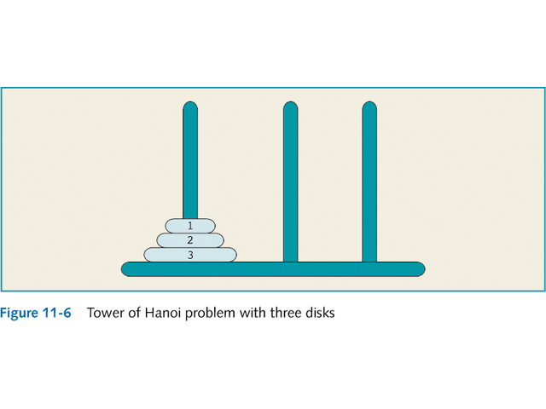
Complexity: Tower of Hanoi

Slide 70
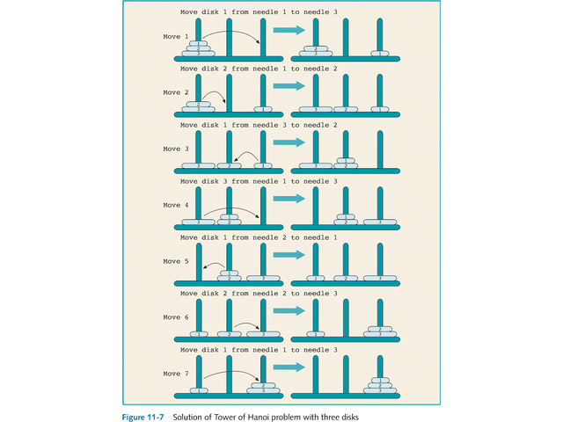
Complexity: Tower of Hanoi

Slide 71
Complexity: Tower of Hanoi
3-disk problem: 2³ - 1 = 7 moves
64-disk problem: 2⁶⁴ - 1.
2¹⁰ = 1024 ≈ 1000 = 10³,
2⁶⁴ = 2⁴ * 2⁶⁰ ≈ 2⁴ * 10¹⁸ = 1.6 * 10¹⁹
One year ≈ 3.2 * 10⁷ seconds

Slide 72
Complexity: Tower of Hanoi
The wizard’s speed = one disk / second
1.6 * 10¹⁹ = 5 * 3.2 * 10¹⁸ =
5 * (3.2 * 10⁷) * 10¹¹ =
(3.2 * 10⁷) * (5 * 10¹¹)
500 billion years

Slide 73
Complexity: Tower of Hanoi
The time required to move all 64 disks from needle 1 to needle 3 is roughly 5 * 10¹¹ years.
It is estimated that our universe is about 15 billion = 1.5 * 10¹⁰ years old.
5 * 10¹¹ = 50 * 10¹⁰ ≈ 33 * (1.5 * 10¹⁰).

Slide 74
Complexity: Tower of Hanoi
Assume: a computer with 1 billion = 10⁹ moves/second.
Moves/year=(3.2 *10⁷) * 10⁹ = 3.2 * 10¹⁶
To solve the problem for 64 disks:
2⁶⁴ ≈ 1.6 * 10¹⁹ = 1.6 * 10¹⁶ * 10³ =
(3.2 * 10¹⁶) * 500
500 years for the computer to generate 2⁶⁴ moves at the rate of 1 billion moves per second.

Slide 75
Complexity
Why worry about complexity of algorithms?
because a problem may be solvable in principle but may take too long to solve in practice
How can we evaluate the complexity of algorithms?
through asymptotic analysis, i.e., estimate time (or number of operations) necessary to solve an instance of size n of a problem when n tends towards infinity
See AIMA, Appendix A.

Slide 76
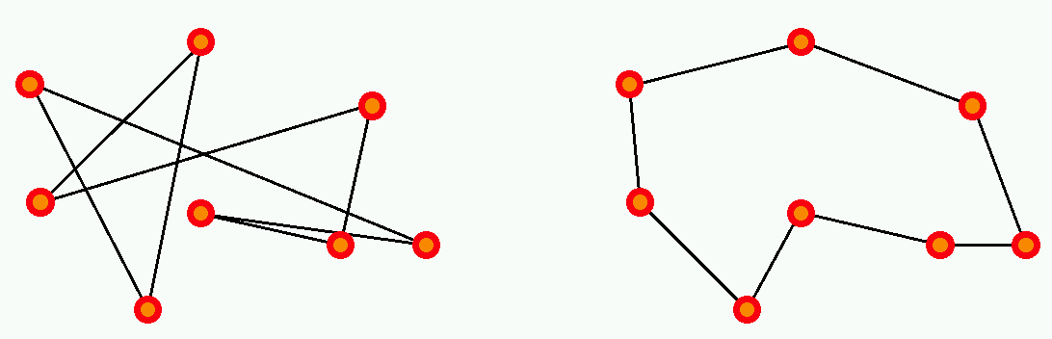
Complexity example: Traveling Salesman Problem
There are n cities, with a road of length L_{ij} joining
city i to city j.
The salesman wishes to find a way to visit all cities that
is optimal in two ways:
each city is visited only once, and
the total route is as short as possible.

Slide 77
Complexity example: Traveling Salesman Problem
This is a hard problem: the only known algorithms (so far) to solve it have exponential complexity, that is, the number of operations required to solve it grows as exp(n) for n cities.

Slide 78
Why is exponential complexity “hard”?
It means that the number of operations necessary to compute the exact solution of the problem grows exponentially with the size of the problem (here, the number of cities).
exp(1) = 2.72
exp(10) = 2.20 10⁴ (daily salesman trip)
exp(100) = 2.69 10⁴³ (monthly salesman planning)
exp(500) = 1.40 10²¹⁷ (music band worldwide tour)
exp(250,000) = 10^{108,573} (fedex, postal services)
Fastest computer = 10¹² operations/second

Slide 79
So…
In general, exponential-complexity problems cannot be solved for any but the smallest instances!

Slide 80
Complexity
Polynomial-time (P) problems: we can find algorithms that will solve them in a time (=number of operations) that grows polynomially with the size of the input.
for example: sort n numbers into increasing order: poor algorithms have n^2 complexity, better ones have n log(n) complexity.

Slide 81
Complexity
Since we did not state what the order of the polynomial is, it could be very large! Are there algorithms that require more than polynomial time?
Yes (until proof of the contrary); for some algorithms, we do not know of any polynomial-time algorithm to solve them. These belong to the class of nondeterministic-polynomial-time (NP) algorithms (which includes P problems as well as harder ones).
for example: traveling salesman problem.
In particular, exponential-time algorithms are believed to be NP.

Slide 82
Note on NP-hard problems
The formal definition of NP problems is:
A problem is nondeterministic polynomial if there exists some algorithm that can guess a solution and then verify whether or not the guess is correct in polynomial time.
(one can also state this as these problems being solvable in polynomial time on a nondeterministic Turing machine.)
In practice, until proof of the contrary, this means that known algorithms that run on known computer architectures will take more than polynomial time to solve the problem.

Slide 83
Complexity: O () and o() measures (Landau symbols)
How can we represent the complexity of an algorithm?
Given: Problem input (or instance) size: n
Number of operations to solve problem: f(n)
If, for a given function g(n), we have: // for some k
then f is dominated by g
If, for a given function g(n), we have: // for all k
then f is negligible compared to g

Slide 84
Landau symbols
is bounded

Slide 85
Examples, Properties
f(n)=n, g(n)=n²:
n is o(n²), because n/n² = 1/n -> 0 as n ->infinity
similarly, log(n) is o(n)
n^{C} is o(exp(n)) for any C
if f is O(g), then for any K, K*f is also O(g); idem for o()
if f is O(h) and g is O(h), then for any K, L: (K*f + L*g) is O(h)
idem for o()
if f is O(g) and g is O(h), then f is O(h)
if f is O(g) and g is o(h), then f is o(h)
if f is o(g) and g is O(h), then f is o(h)

Slide 86
Polynomial-time hierarchy
See Handbook of Brain Theory & Neural Networks
(Arbib, ed.; MIT Press 1995).
NP
P
AC⁰
NC¹
NC
P complete
NP complete
AC⁰: can be solved using gates of constant depth
NC¹: can be solved in logarithmic depth using 2-input gates
NC: can be solved by small, fast parallel computer
P: can be solved in polynomial time
P-complete: hardest problems in P; if one of them can be proven to be
NC, then P = NC
NP: nondeterministic-polynomial algorithms
NP-complete: hardest NP problems; if one of them can be proven to be
P, then NP = P
PH: polynomial-time hierarchy
PH

Slide 87

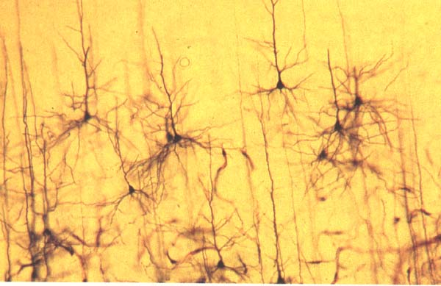
Complexity and Human Brain
Are computers close to human brain power?
Current computer chip (CPU):
10^3 inputs (pins)
10^7 processing elements (gates)
2 inputs per processing element (fan-in = 2)
processing elements compute boolean logic (OR, AND, NOT, etc)
Typical human brain:
10^7 inputs (sensors)
10^10 processing elements (neurons)
fan-in = 10^3
processing elements compute complicated functions
Still a lot of improvement needed for computers; but
computer clusters come close!

Slide 88
Summary
This Week:
Problem formulation usually requires abstracting away real-world details to define a state space that can be explored using computer algorithms.
Once problem is formulated in abstract form, complexity analysis helps us picking out best algorithm to solve problem.
Next Week:
Variety of uninformed search strategies; difference lies in method used to pick node that will be further expanded.
Iterative deepening search only uses linear space and not much more time than other uniformed search strategies.

